Slide 1

GTA Housing Market, Data Analytics and Machine Learning
Yikki
Dr Who.
Jasmine
Hassan Mehmood

Slide 2







OUTLINE OF THE WHOLE PRESENTATION
EXECUTIVE SUMMARY
INTRODUCTION
METHODOLOGY
FINDINGS
RESULTS
CONCLUSION AND FUTURE WORK
Q&A AND APPENDIX

Slide 3

EXECUTIVE SUMMARY
Data Analysis and Modeling: The project involves preprocessing housing data, normalizing it, and training multiple regression models (Linear Regression, XGBoost, Ridge, Lasso, and Decision Tree) to predict the average house price based on various features.
Model Evaluation: The models are evaluated using cross-validation, grid search for hyperparameter tuning (especially for XGBoost), and RMSE (Root Mean Squared Error) to assess their predictive accuracy.
Comparison and Visualization: The performance of each model is compared based on their RMSE, and the results are visualized using a bar plot to determine the most effective model for the prediction task.

Slide 4
METHODOLOGY
Importing data
EDA
Statistical Analysis
Illustrations and Findings
Model Selection
Hopefully front End by the end of it
Results
Q&A
Conclusion and Appendix

Slide 5
Exploratory Data Analysis
1. Historical home price in GTA from 2001 to 2021
Sourced from Toronto Regional Real Estate Board
112,860 rows x 15 columns
Features:
Year
Municipality
Sales
Dollar Volume
Average Price
New Listings
Average DOM
Building Type
Recession Indicator
5 Year Interest Rate
Target Variable:
Average Price
Comparison with similar projects:
Using venues data and school rankings
Using income of neighborhood and handcrafted housing dataset
Notes:
Datasets used in our project: [Historical home price in GTA from 2001 to 2021] which is sourced from Toronto Regional Real Estate Board. The dataset includes 112,860 rows x 15 columns.
Key variables include Year and quarter, municipality, number of sales, dollar volume, and building type
[Interest rates] which is sourced from [*]. The dataset includes 87 rows x 2 columns
[Recession indicator] which is sourced from [*]. The dataset includes 86 rows x 6 columns
There are similar projects we found online that were also predicting the housing price in GTA, in particular
using venues data and school rankings
using income of neighbourhood and handcrafted housing dataset
Our project focuses on exploring the housing market trends by comparing with the inflation and interest rate changes

Slide 6
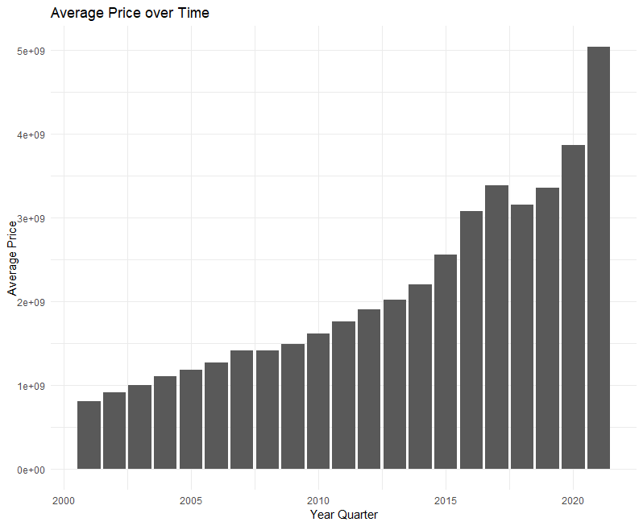
Price over the years

Slide 7
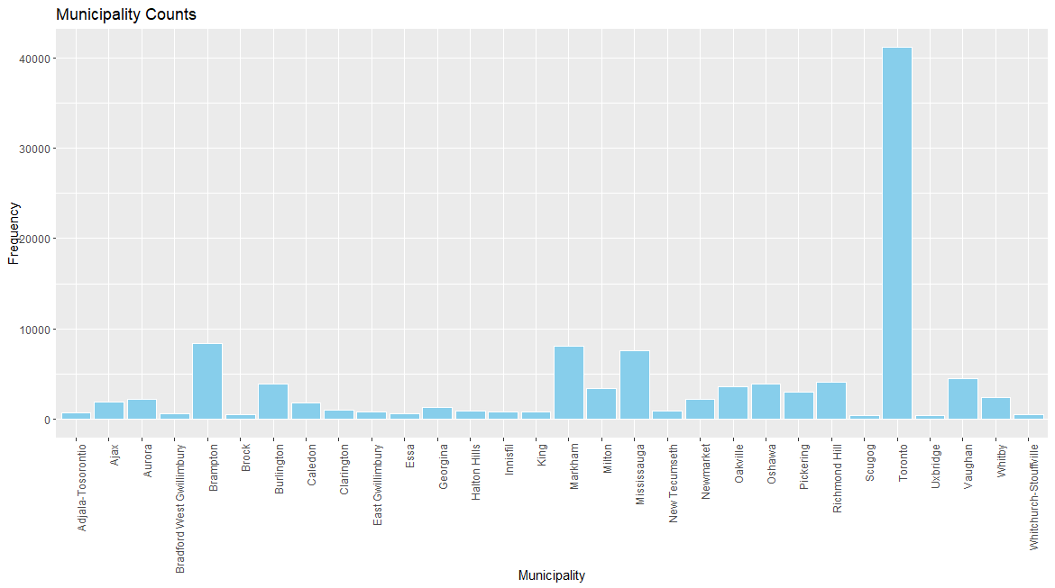
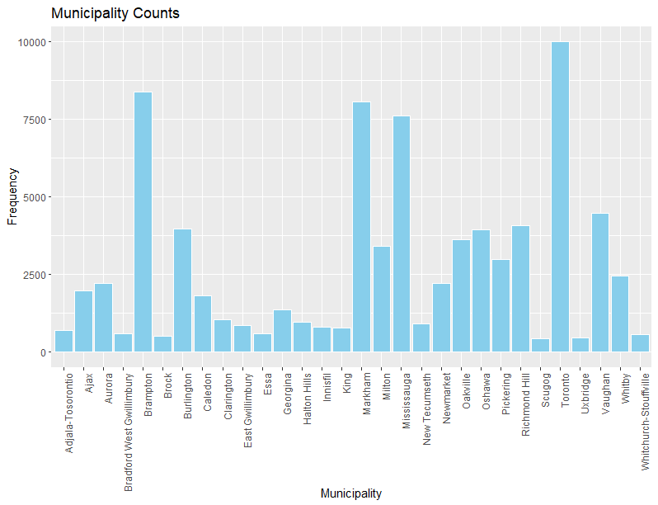
Imbalanced Data

Slide 8
Data Cleaning Process
Made a function for the following steps:
View columns
Check for nulls and identify columns with any null values
Check for duplicates
Return a summary report for each dataset performing the above steps
Merge the datasets by “Year_Quarter_Key”
Remove unnecessary columns
=> Final dataset: 112,860 rows x 12 columns
Notes:
CANRECDM: OECD based Recession Indicators for Canada from the Peak through the Trough (CANRECDM)

Slide 9
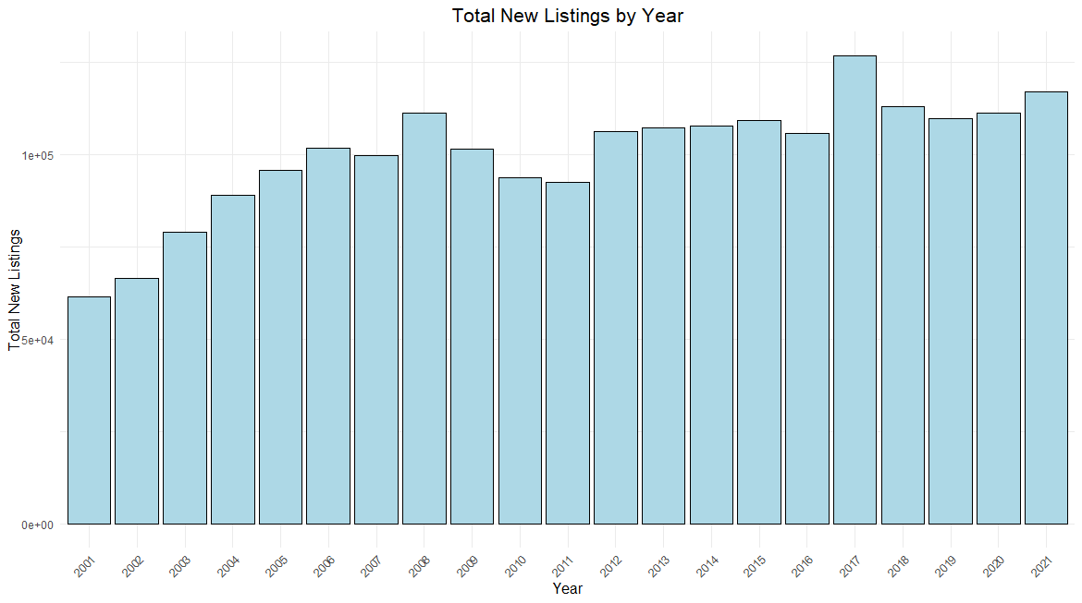
Total New Listings by Year

Slide 10
Statistical Analysis
Factor Analysis
Correlation
Distribution

Slide 11
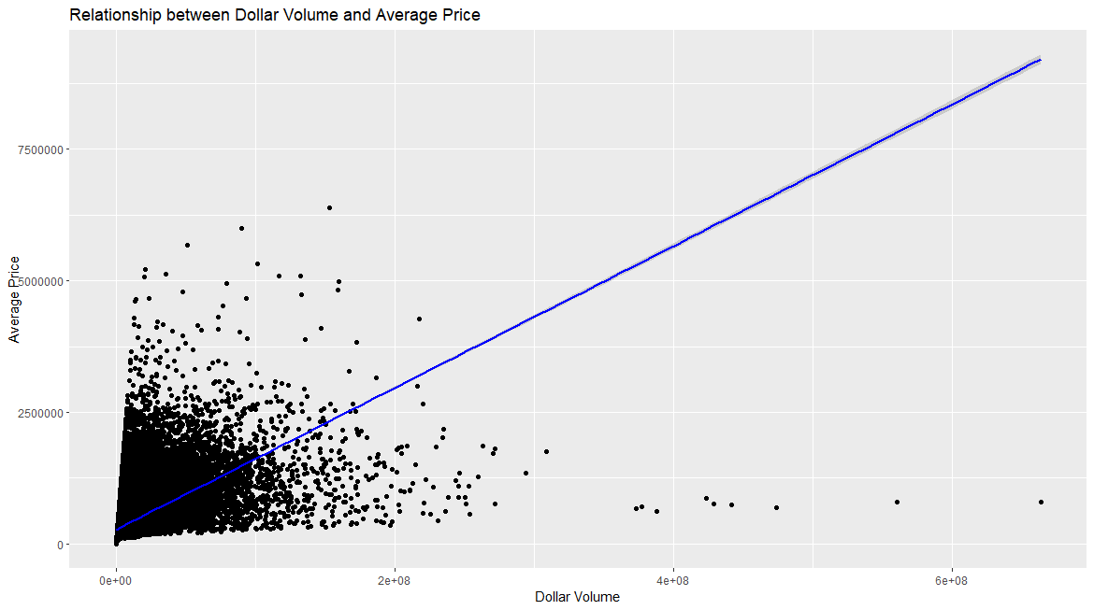
Dollar Volume and Average Price

Slide 12
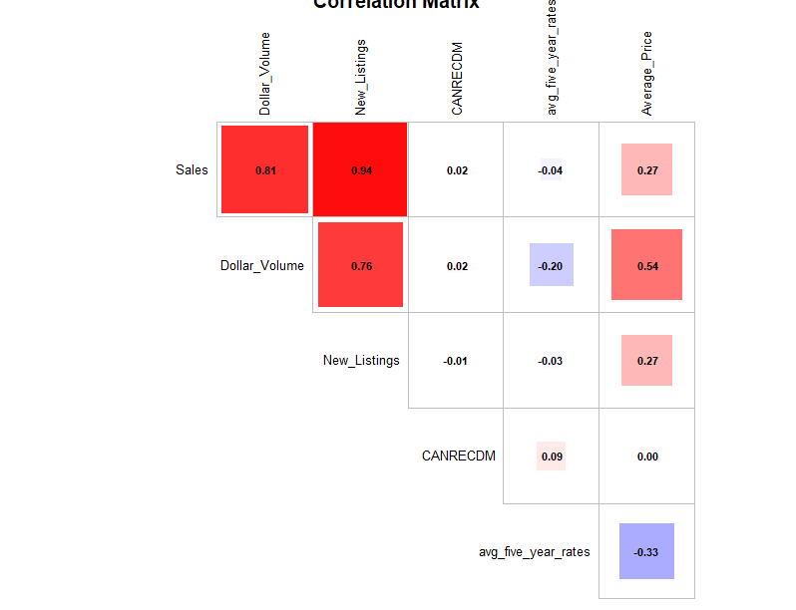
Correlation

Slide 13
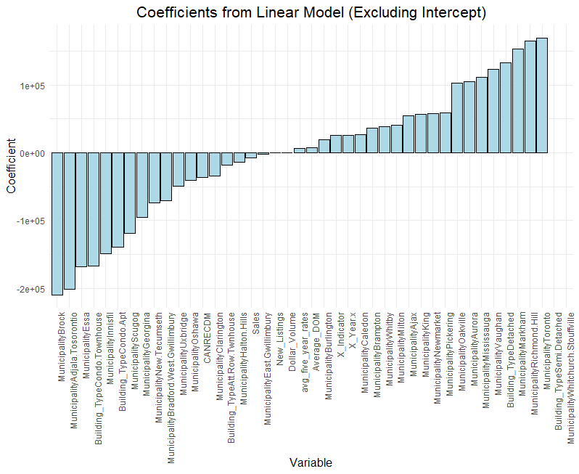
Factor Analysis

Slide 14
KEY FINDINGS
This section will have information about our data
Findings with EDA
Findings with Statistical Analysis

Slide 15
BaseLine Models
Following Machine Learning models were used to make their individual baseline :
Linear Regression: No regularization
XGBoost
Ridge Regression: L2 regularization (shrinkage)
Lasso Regression: L1 regularization (feature selection)
Decision Tree

Slide 16
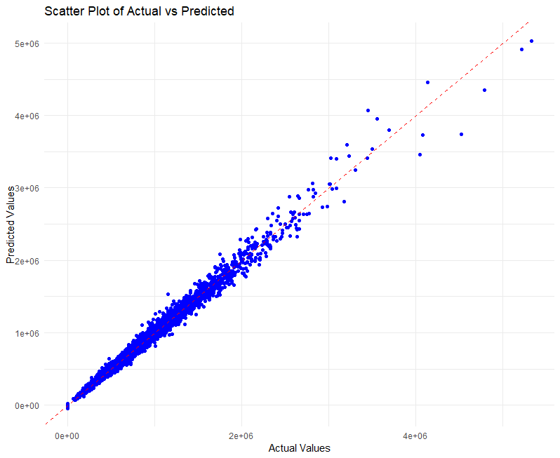
XGBoost Actual Vs Predicted

Slide 17
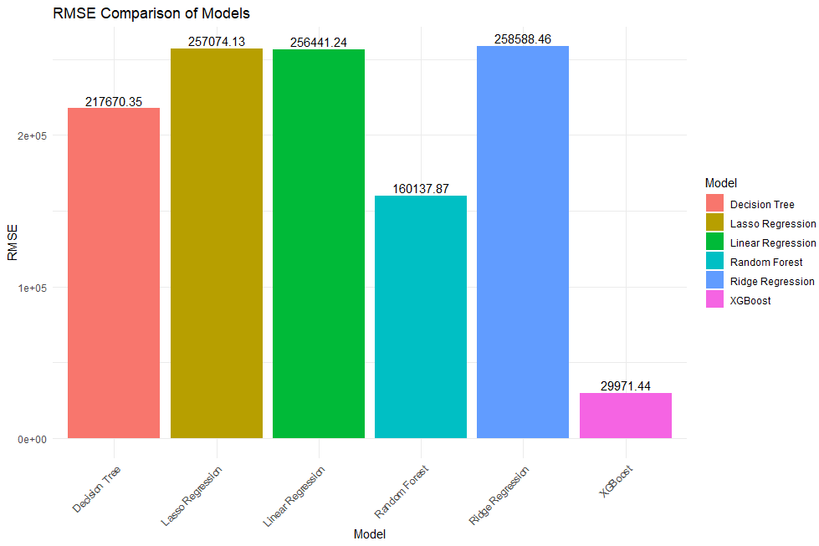

Slide 18
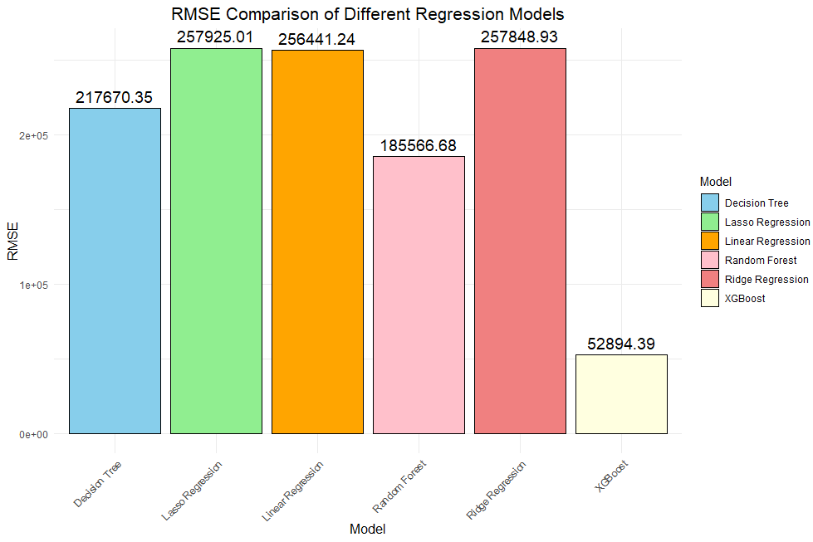
With Normalized Data:

Slide 19
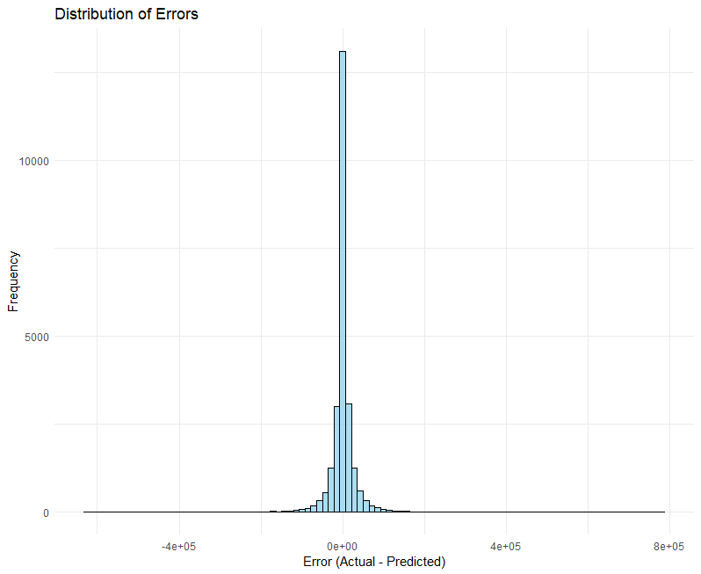
XGBoost Error Distribution

Slide 20
Fine Tuning and Robustness:
K-FOLD Validation
Normalizing Data
Grid search parameter Tuning

Slide 21
CONCLUSION AND FUTURE WORK

Slide 22
Q&A AND APPENDIX

